Slide 1
Day 09: Supervised Learning
التعلم بالإشراف
Data Scientist using Python | Jun 2026 Algiers

Slide 2
Two cultures of modeling
Breiman (2001), “Statistical Modeling: The Two Cultures” · Shmueli (2010), “To Explain or to Predict?”
Traditional analysis
(econometrics)
Data science
(algorithmic culture)
Goal: explanation & causal inference — estimate β, test hypotheses
Model specified a priori from theory
Structured, curated samples; small-to-medium n
Validation: in-sample fit, diagnostics, robustness
Tools (EViews, SPSS, JASP, Stata)
Output: paper or report with parameters
Goal: prediction & decision support — minimize out-of-sample error
Model selected by validation performance
Structured + unstructured data; massive n and p
Validation: held-out test sets, cross-validation
Tools (Python, R, Julia)
Output: deployed model, dashboard, decision system
Warning: prediction ≠ causation (Mullainathan & Spiess, 2017) — and the cultures are now converging in causal ML.

Slide 3
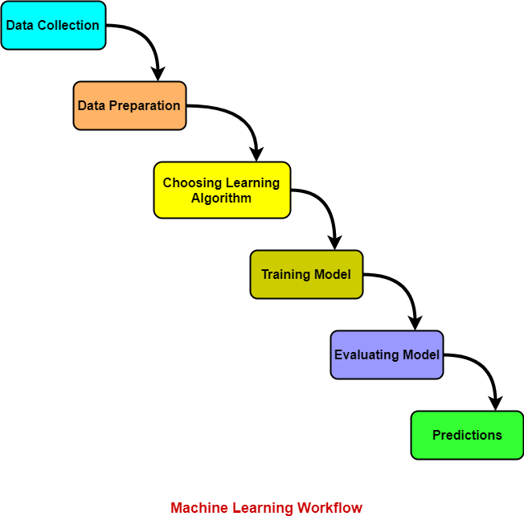
Machine Learning Workflow

Slide 4
The eight steps of a data science project
CRISP-DM heritage (Shearer, 2000)
1
5–10%
2
10%
3
30–50%
4
10–15%
Define the problem
Acquire data
Clean & prepare
Explore (EDA)
question + success metric
APIs, databases, scraping
missing values, duplicates
Summary statistics, distributions, correlation analysis
5
10–15%
6
10%
7
5–10%
8
10%
Engineer features
Model
Evaluate
Communicate & deploy
domain knowledge pays here
baseline first, then compare
out-of-sample vs. naive
report, dashboard, API
Cleaning takes 30–50% of real project time — budget for it.

Slide 5
ML Vocabulary
Input | X
Output | Y
Rows | m
Features | Xi
h(x) | Prediction function
Cost J | Cost function
Theta | Weights

Slide 6

Scikit Learn

Slide 7
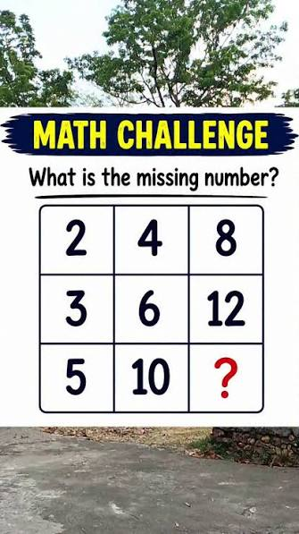
What is Prediction?

Slide 8
Types of Data ?
Structured and Unstructured data
((بيانات هيكلية و بيانات غير هيكلية
Labeled and Unlabeled data
بيانات تحتوي على مدخلات و مخرجات و بيانات تحتوي على مدخلات فقط
Training data and Testing data
بيانات التدريب و تستعمل لبناء الخوارزمية، أما بيانات التقييم فتكون بغية اختبار مدى نجاح الخوارزمية

Slide 9
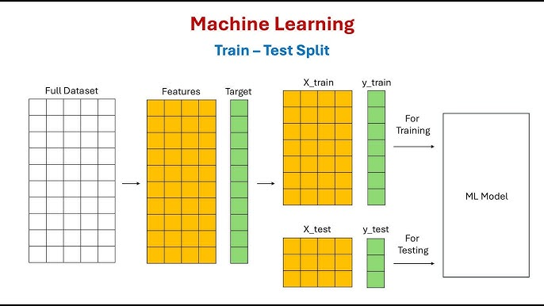
Train and Test (Split Function)

Slide 10
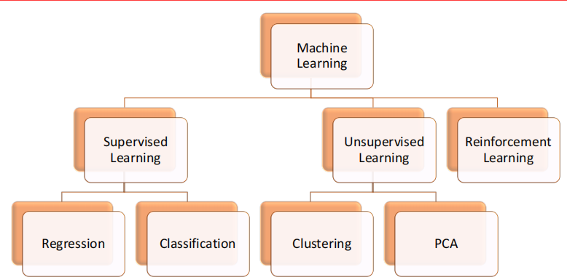
Machine Learning Models

Slide 11
Supervised Learning
Regression
Labeled data
Quantitative
OUTPUT
Classification
Labeled data
Categorical
OUTPUT

Slide 12
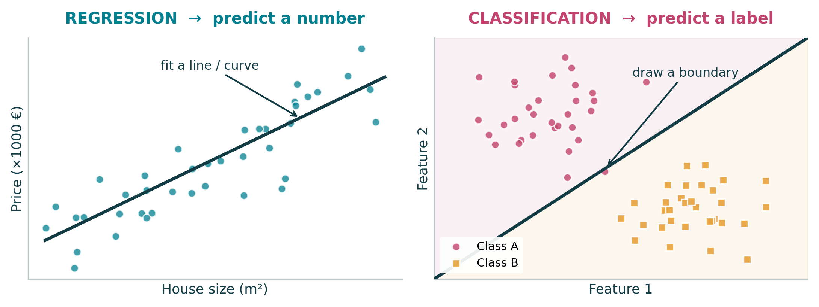
Supervised = we train on examples where the correct answer (the label) is already known. The only thing that changes between the two families is what kind of answer we want back.
1
THE BIG PICTURE
Notes:
Ask the class for examples before revealing the cards. Trap to point out: 'predict the exam grade 0-20' is regression, 'predict pass/fail' is classification — same data, different question. Also flag that Logistic Regression is a CLASSIFIER despite its name; we'll get to it.

Slide 13
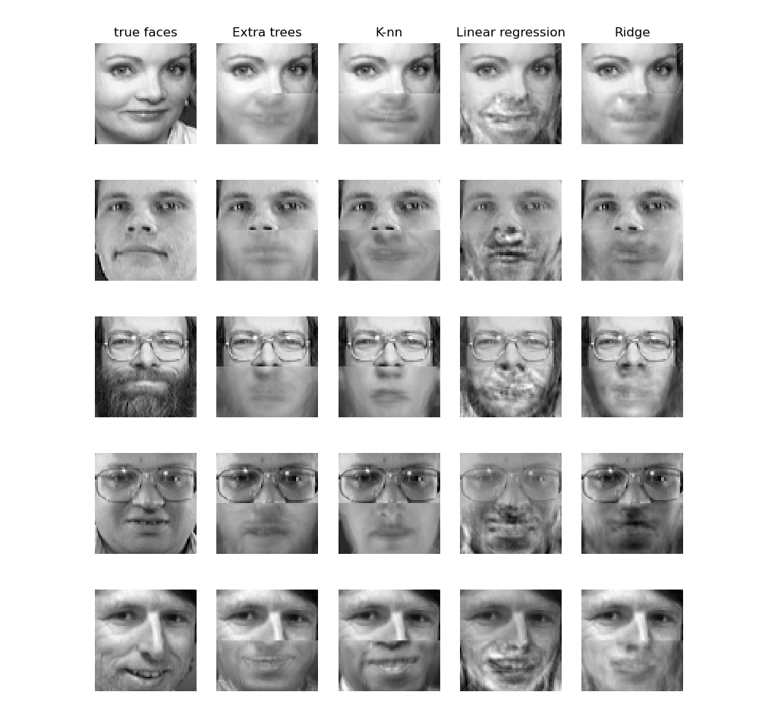

Slide 14
Regression

Slide 15
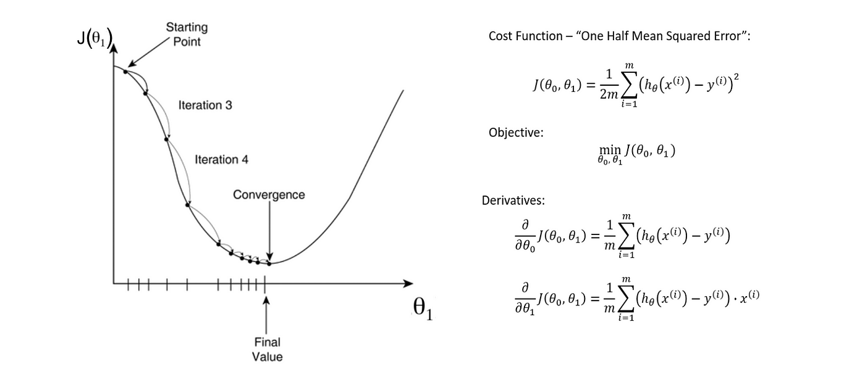
Regression : 1. Gradient Descent

Slide 16
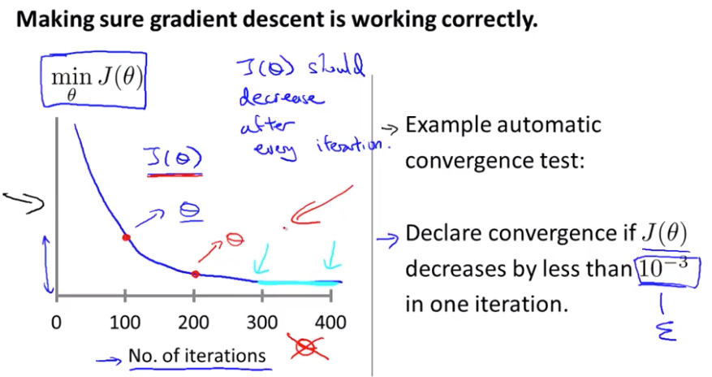
How does it work?

Slide 17
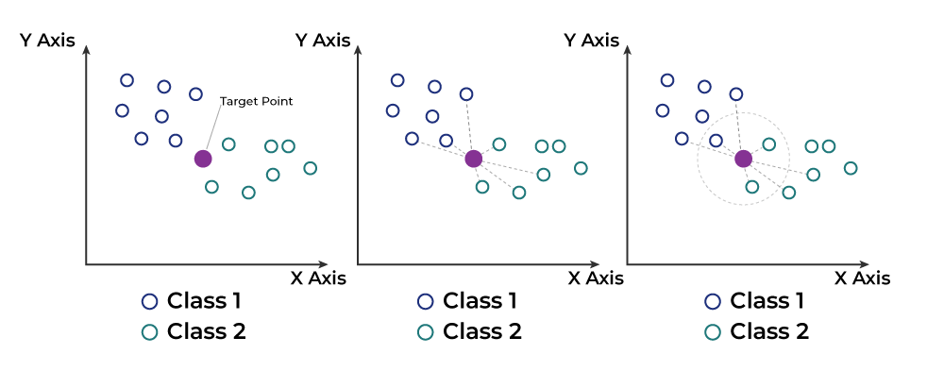
Regression: 2. KNN algorithm
Step 1: Selecting the optimal value of K;
Step 2: Calculating distance;
Step 3: Finding Nearest Neighbors;
Step 4: Taking Average for Regression.

Slide 18
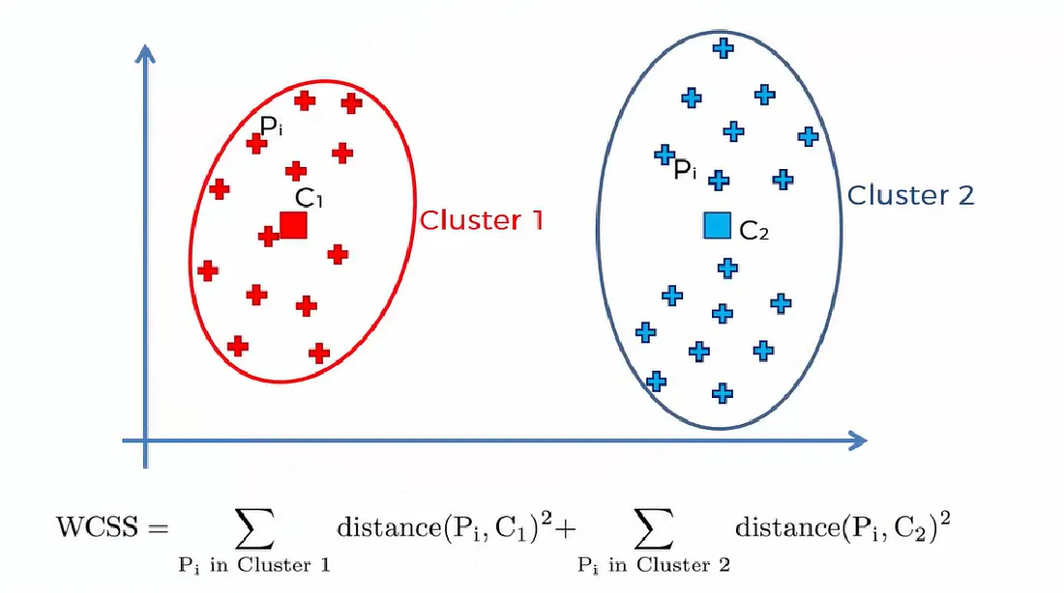
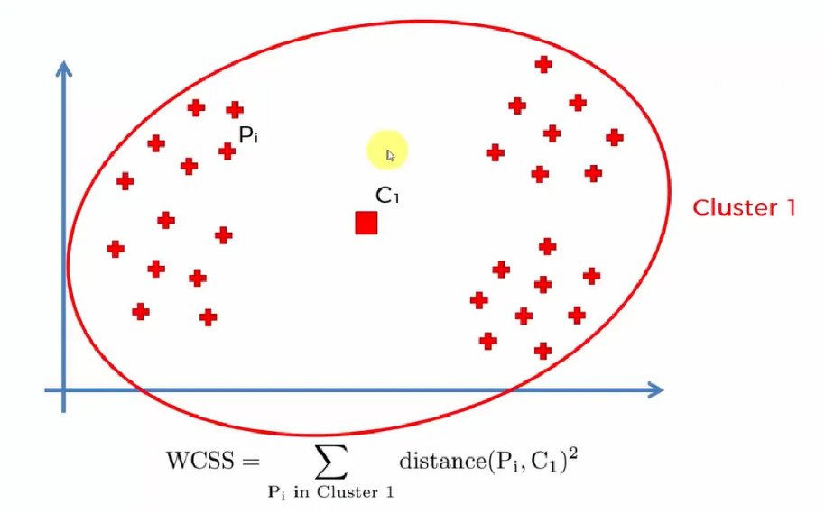
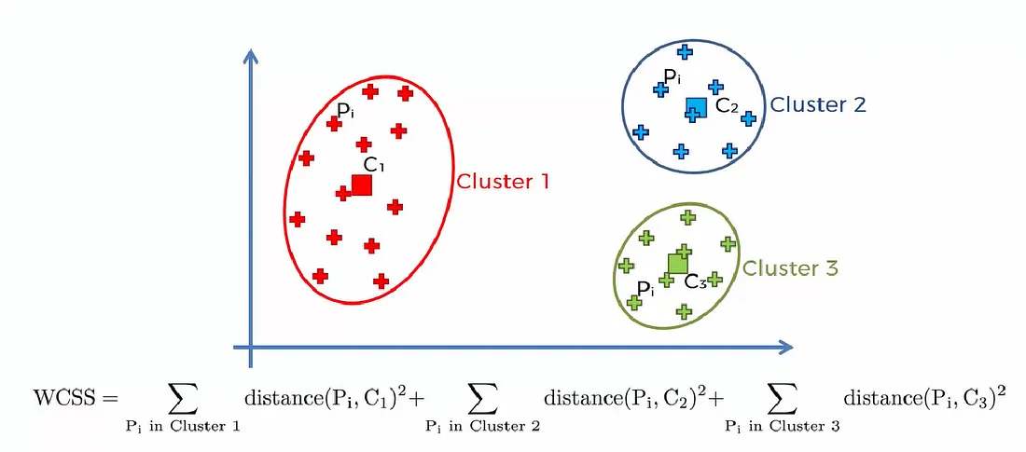
How does it work?

Slide 19
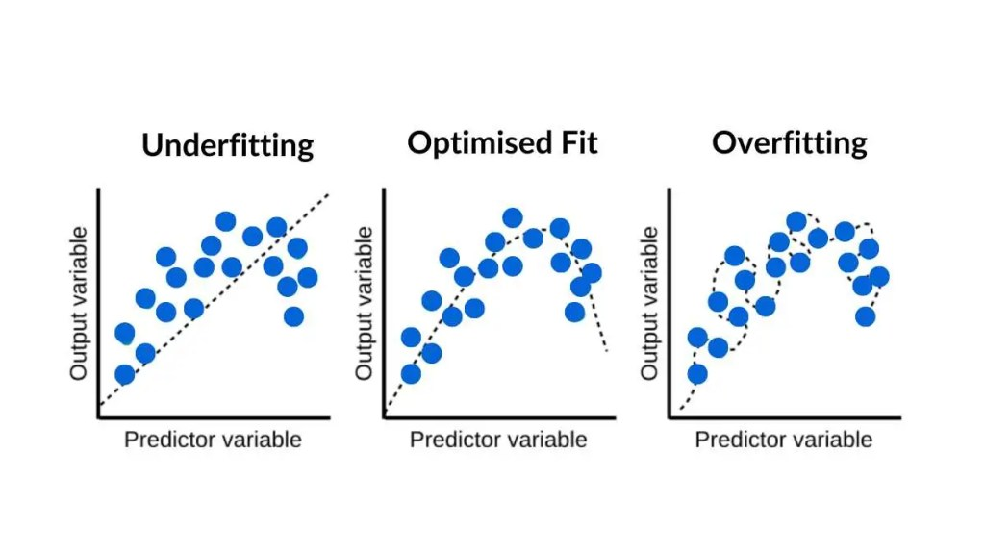
Regression : 3. Ridge and Lasso

Slide 20
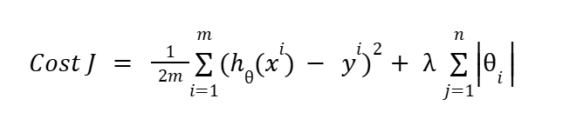
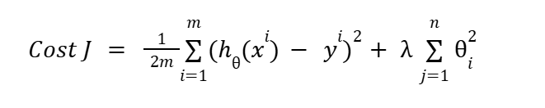
How to correct overfitting?
Lasso
Ridge

Slide 21
How to correct underfitting?
Optimize Hyperparameters
Clean your data
Features engineering

Slide 22
Validation Metrics
RMSE
MAE
R squared

Slide 23
Classification

Slide 24
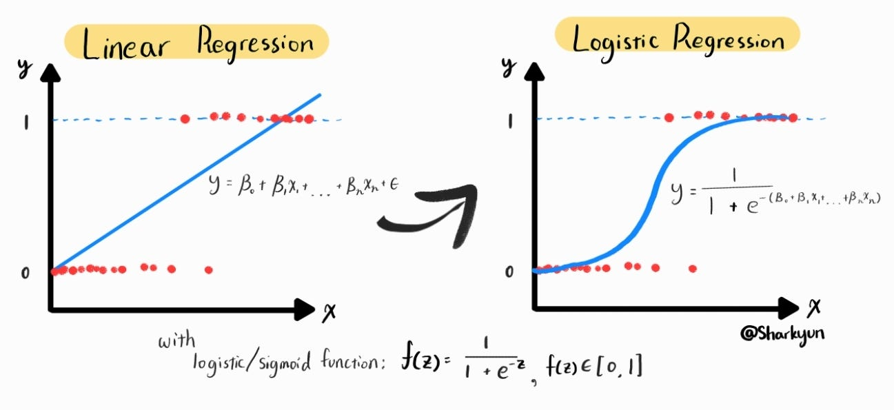
Classification : 1. Logistic Regression (Binary Classification)

Slide 25
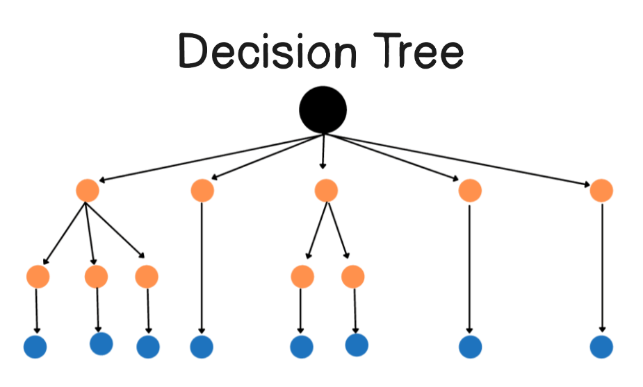
Classification : 2. Decision Tree
Decision Trees (DTs) are a non-parametric supervised learning method used for classification and regression. The goal is to create a model that predicts the value of a target variable by learning simple decision rules inferred from the data features.

Slide 26
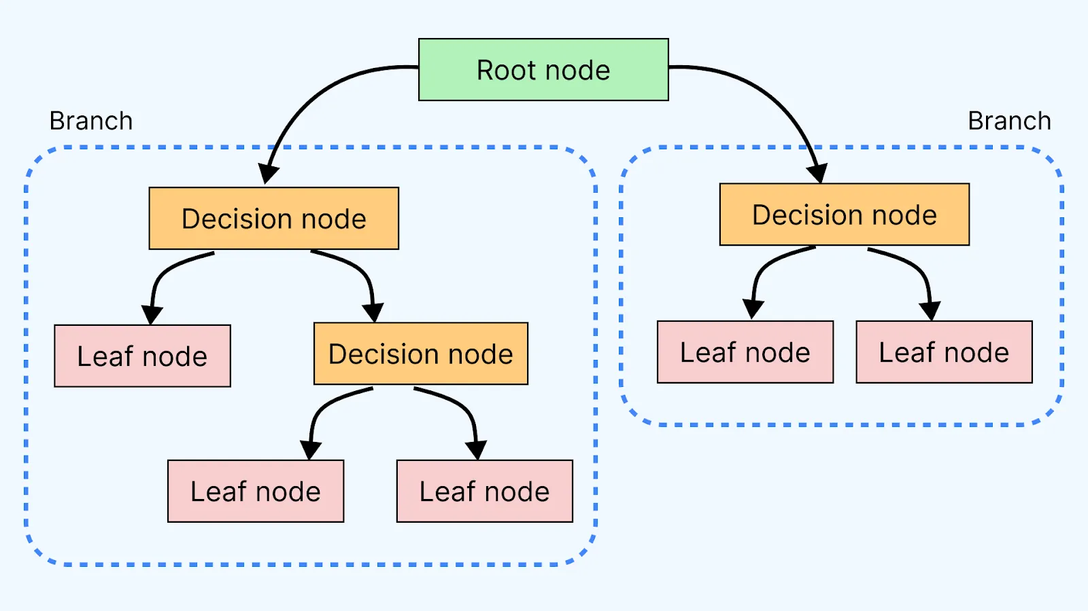
Componenets of Decision Tree
Root Node: Starting point representing the whole dataset.
Branches: Lines connecting nodes showing the flow from one decision to another.
Leaf Nodes: End points of the tree where the final decision or prediction is made.

Slide 27
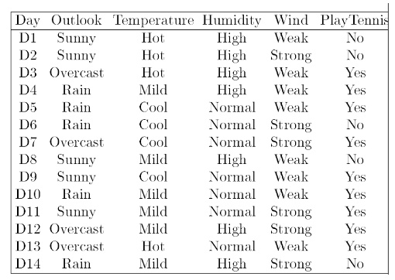
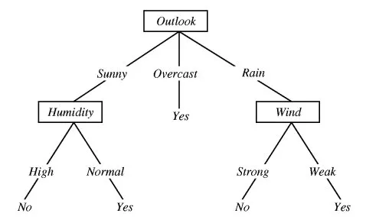
Pure and Impure Nodes
Purity (Pure split or Not) ?
Features Selection?

Slide 28
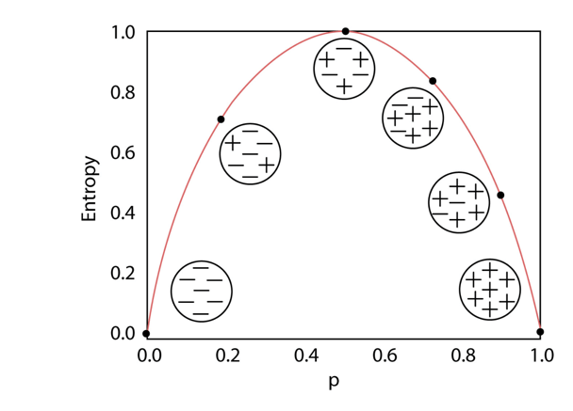

Slide 29
Validation Metrics
Accuracy
Recall
Precision

Slide 30
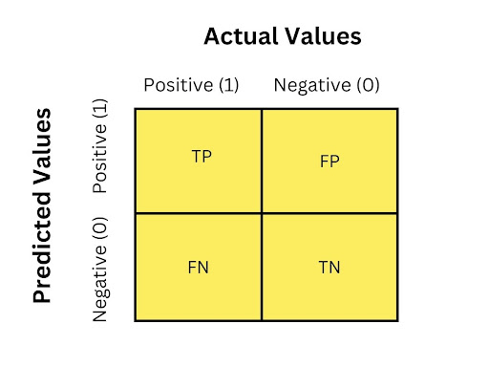
Logistic Regression
(Confusion Matrix)
A confusion matrix is a table used to evaluate the performance of a classification model (like logistic regression).

Slide 31
Logistic Regression
(Performance Metrics)
Metric | Formula | Interpretation
Accuracy | (TP + TN) / (TP + TN + FP + FN) | % of correct predictions
Precision | TP / (TP + FP) | % of predicted positives that are actually positive
Recall (Sensitivity) | TP / (TP + FN) | % of actual positives correctly detected
Specificity | TN / (TN + FP) | % of actual negatives correctly detected
F1 Score | 2 × (Precision × Recall) / (Precision + Recall) | Harmonic mean of precision and recall

